Slide 1
CSC 101 Applied Physics Spring 2023

Slide 2
The second part of
(CSC101 Applied Physics)
is
Engineering Mechanics
Statics and Dynamics
Recommended book:
Engineering Mechanics
Statics and Dynamics
By R.C. Hubbeler 11th Edition or 12th Edition

Slide 3
Engineering Mechanics
Ch-2: Force Vectors
Topics in this lecture:
Scalars and Vectors-Definitions
2. Examples of Scalar and Vector
3. Vector Operations
4. Addition of vectors
5. Parallelogram law
6. Triangular Law
7. Multiple vectors

Slide 4
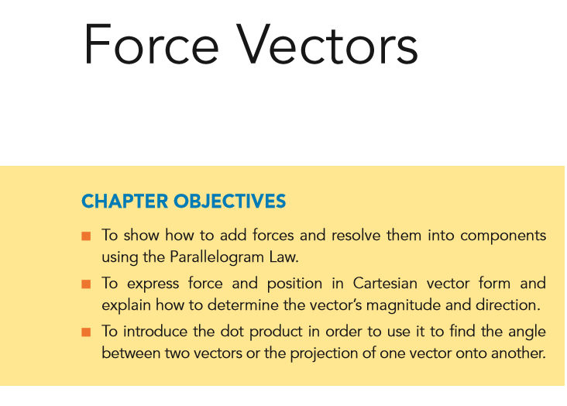
Engineering Mechanics
Ch-2: Force Vectors

Slide 5
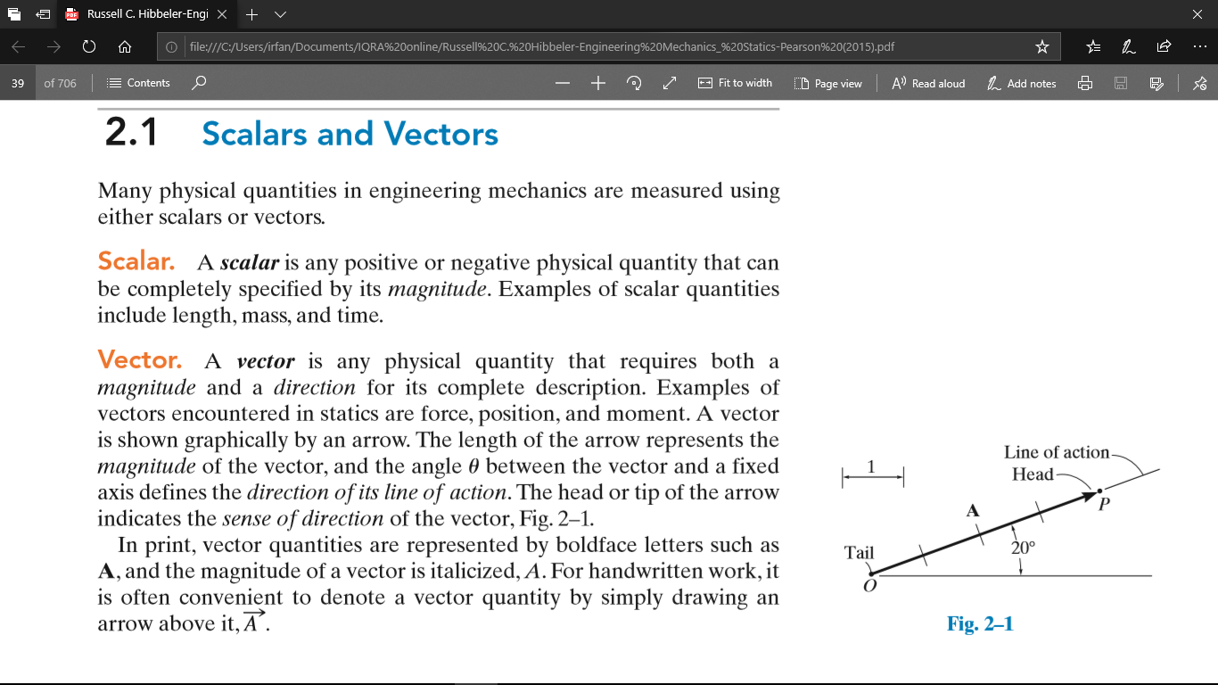
Engineering Mechanics

Slide 6
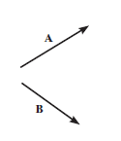
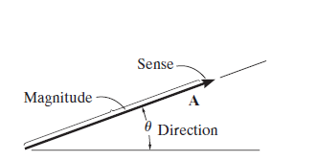
Force Vectors

Slide 7


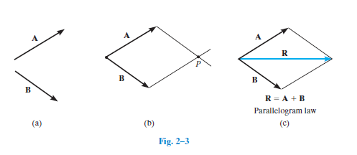
Engineering Mechanics

Slide 8
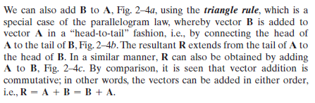
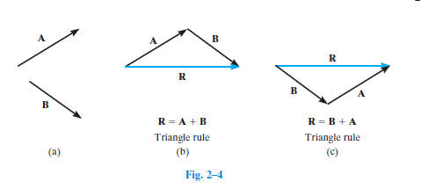

Slide 9
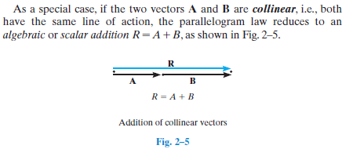
Collinear Vectors

Slide 10
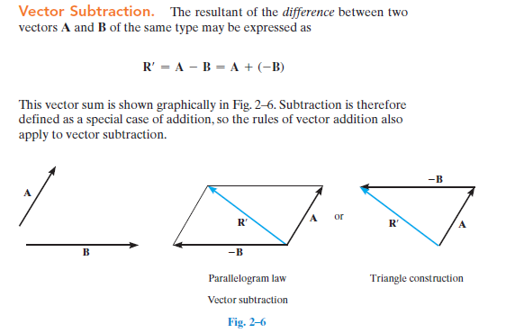

Slide 11
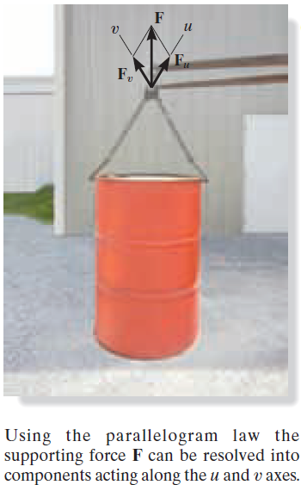
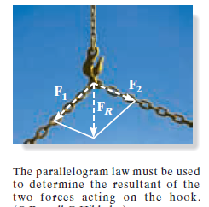
Examples of vector addition

Slide 12

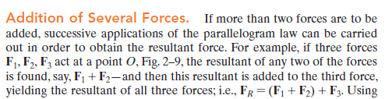
Addition of multiple force vectors
F2
F1
F3

Slide 13
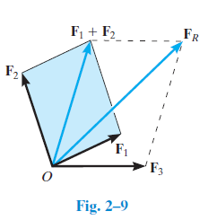
Addition of multiple force vectors
F2
F1
F3

Slide 14
Engineering Mechanics
Ch-2: Force Vectors
Topics in next lecture:
Cartesian vectors
Right hand Cartesian
3. Rectangular components vectors
4. Representation of Cartesian vectors
5. Magnitude of Cartesian vectors
6. Direction angles

